Slide 1
Planetary Transits

Slide 2
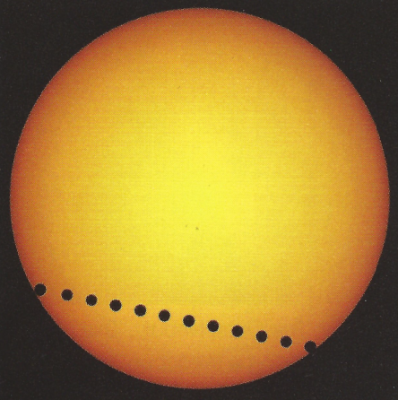
What is a Planetary Transit?
The passage of a smaller body across the disk of a larger body
From Earth it is only possible to observe Mercury and Venus
First observed in 1631 by Gassendi
Notes:
planetary transit is the passage of a relatively small body i.e. a planet across the disk of a larger body i.e. a star. For example, in our solar system occasionally Venus and Mercury line up between the Earth and the Sun as seen in Figure 1. The first transit observed was by French astronomer Gassendi of Mercury in 1631.

Slide 3
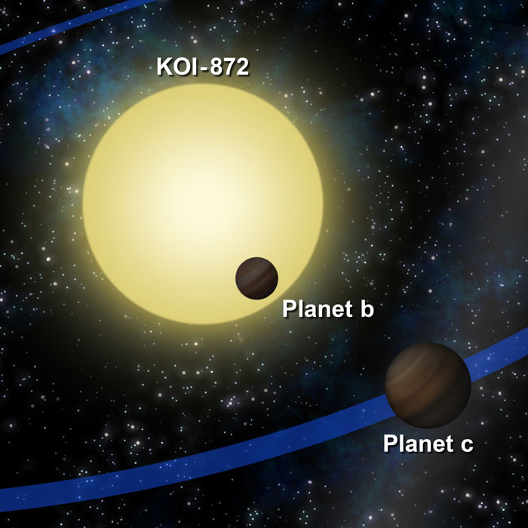
Why are Planetary Transits important?
Can be used to discover planets outside of our solar system (i.e. exoplanets)
Presently there is limited technology available
Not possible to directly observe exoplanets
Notes:
Planetary transits are important as they can be used as a method to discover exoplanets
Currently, the technology does not exist to directly observe exoplanets, which is why adopting this method (and other methods) is key to achieving data which can prove their existence and determine their properties.

Slide 4
Are Planetary Transits the only way to detect exoplanets?
Astrometry: Measures the slight wobble induced by a planet on its parent star
Unable to convincingly confirm the existence of exoplanets
Radial Velocity: Also measures the wobble of the star
Gravitational tug causes a doppler shift in the stars spectral lines.
Gravitational microlensing: Measures the light amplification of a star
If a smaller star passes in front of our line of sight its gravitational field acts as a lens
Possible to detect earth sized planets with this method
Transits: If a planet moves directly in front of a star a dip in luminosity is observed
Can be used to find a number of characteristics including radius, density and temperature.
Notes:
Measures the slight wobble in the otherwise straight-line path of a parent star across the sky. It is the gravitational tug of massive planets that is believed to cause these tiny wobbles. Although this is the oldest method used, it cannot convincingly confirm the existence of exoplanets as well as any of their properties.
Radial Velocity – measures the wobble induced by a parent star. The gravitational tug of massive planets would cause a small but measurable periodic Doppler shift in a star’s spectral lines. The Sun-like star 51 Pegasi, 50 light years away, was reported to show slight radial velocity variations in 1995. These variations are attributed to the first confirmed extrasolar planet. Other properties such as the atmospheric composition of exoplanets can be analysed using this method.
3. Gravitational microlensing – Measures the light amplification by the candidate visible star. If a faint star is along our line of sight to a brighter, more distant star, its gravitational field would act as a lens to amplify the bright starlight. Planets orbiting the intervening star would cause a tiny change in the light amplification. Although the chance of this event is slim, it is a method that is possible to detect earth-sized exoplanets.
4. Transits – Also known as photometry, it is based upon measuring the light output of the candidate visible star. A planet that moves directly in front of its star along our line of sight would cause a slight dip in brightness. This dip in brightness indicates the presence of exoplanets. The advantages of using this method are that it can be used to determine numerous properties of the exoplanet such as its size, mass, temperature, density. The disadvantages are that in order to view a planet transit, a planet must be perfectly aligned from the viewer’s vantage point, and the chance of this happening is around 0.47%.

Slide 5
Project Aim
Use observational data from the Liverpool Telescope to validate the existence of exoplanets
Given 100 images taken over a period of 4.5 hours showing the entire transit
Found the brightness of Hat-P5 for each frame and created a transit curve to display the data
Notes:
Target star: Hat-P5
Data from liverpool telescope using the rise instrument which is a fast-readout camera
Used LT imaging software to find the brightness

Slide 6
Analysis Method
Used the coordinates of the target star to find an image centralised on Hat-P5
This image was compared with the provided data to confirm the position of the star
Data was then observed using LT imaging software which provided the information required to produce a suitable graph
Notes:
The coordinates of the target star, Hat-P-5 were found using SIMBAD, then the coordinates were used to find an image centralised on Hat-P-5 on the website STScI via DSS form.
This image was compared with the data provided by the observations of the Liverpool Telescope of Hat-P-5 to find which star on the data pattern was actually Hat-P-5.
Once Hat-P5 was located, the data was analysed using the LT Image program, which gave each time frame, and the brightness of the star that we were looking at.

Slide 7
Results obtained were too scattered and disordered to produce a suitable graph
Had to consider the effects of the atmospheric conditions
Collected results from a second star and divided by corresponding results for the target star to eliminate atmospheric conditions
Allowed us to get a more convincing transit curve
Notes:
Once Hat-P5 was located, the data was analysed using the LT Image program, which gave each time frame, and the brightness of the star that we were looking at. From this data a transit pattern was expected to be seen; however the data was far too scattered and disordered to produce a suitable graph, and it was far from the transit pattern we were expecting.
Then in order to find a suitable graph pattern, we considered the effects that the atmospheric conditions would have had on the light collected by the telescope, so the results were collected from a second star in the region, and these were divided by the results corresponding to the results from Hat-P5 with the same time frames.
The results showed that the second star followed a similar brightness pattern to our target star, eliminating the atmospheric conditions and possible cloud layers that were affecting these brightness patterns.
Once the brightness for each of the 100 images of Hat-P5 for the 4.5 hour duration were altered by eradicating the atmospheric conditions; they were accounted for and revised in Excel, and a more convincing transit curve was created from these restructured results.

Slide 8
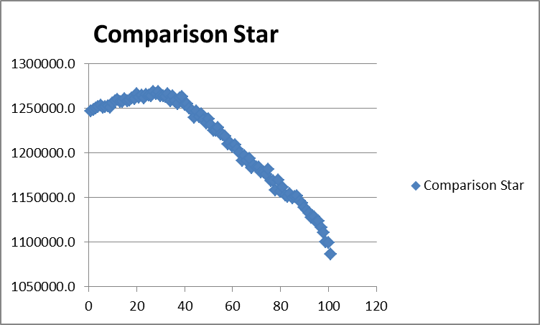
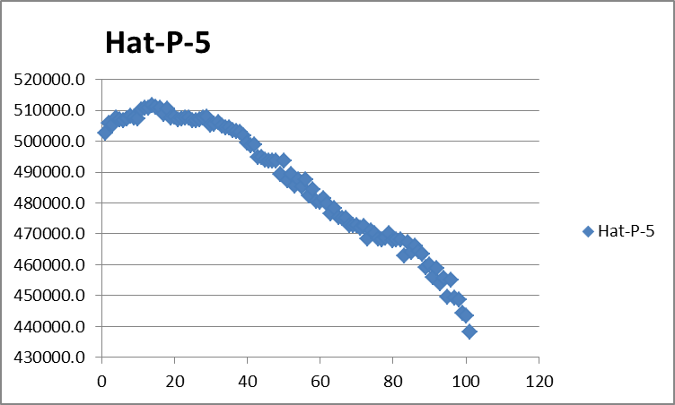

Slide 9
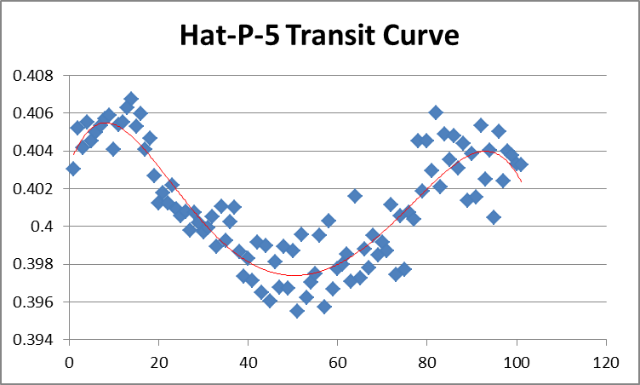

Slide 10
Atmospheric distortion can have a negative impact on the observations
The dip in brightness provides strong evidence to confirm the existence of an exoplanet
Could be confirmed using a different method
Existence of the exoplanet is more strongly verified by the calculations
Notes:
Based on the results, it can be initially concluded that atmospheric distortion has a negative impact on observations and needed to be counteracted by surveying other stars.
It can also be confirmed that using LT Imaging to record the brightness of the star for each frame, and Microsoft Excel to tabulate and create a graph that shows a dip in brightness provides strong evidence that a planetary transit had occurred, verifying the existence of an exoplanet orbiting the HAT-P-5 star however it may be necessary to confirm this with another method other than planetary transit.
Finally, the major conclusion for this exoplanet existing was more strongly verified from the calculations that the radius of the intervening object across HAT-P-5 was too small to be a star (108621.5 km), hence it can only be determined as being a planet.

